Slide 1
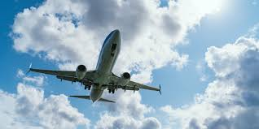
Airline Dataset: Data Cleaning, Analysis & Dashboard.
Group 2
Ngene Christian
Onyinye Alago
Okoye Ogechi
Onyekachi Mavis

Slide 2
1 in 3 flights in this dataset never arrived on time."
We cleaned 500 flight records across 8 airlines to find out why, and who is responsible.

Slide 3
Problem Statement
Airlines generate billions, but dirty, incomplete data makes it impossible to track performance, identify delays, or optimise revenue.
Airlines generate billions in revenue, yet dirty, incomplete data makes it impossible to track performance, identify delays, or optimise revenue. Without reliable data, airlines cannot identify underperforming routes, make informed pricing decisions, or reduce operational delays that cost them passengers and profit. This dataset of 500 flight records across 8 airlines contained inconsistent formats, duplicates, missing values and zero revenue entries masking true performance. Our goal was to clean the data, analyse performance and surface insights that actually drive decisions.

Slide 4
About The Dataset
500 flights. 8 airlines. 3 years of data. One messy dataset.
✈ 500 Flights
🏢 8 Airlines
📅 2022 – 2024
After removing 8 duplicates
Delta, Southwest, Alaska, American, Spirit, United, Frontier, JetBlue
August 2022 – May 2024

Slide 5
Data Cleaning Overview
The data had 8 types of problems. We fixed all of them.
❌ 31 Zero Revenue Rows Fixed
🔁 8 Duplicates Removed
📉 6 Negative Delays Corrected
⚠️ 49 Missing Values Handled
Across 10 cleaning tasks, inconsistent formats, outliers, and data entry errors were identified and resolved before any analysis began.

Slide 6

Data Cleaning Deep Dive
Three problems that required more than a formula.
01 — The Duplicates Excel Missed
Remove Duplicates only caught 1 of 8. Two flights (FL470 and FL029) had the same Flight ID but slightly different airline names and ticket prices , making them look unique. We used COUNTIF to surface all 8 and removed them manually
Missing Ticket Prices Done Right
20 ticket prices were blank. Instead of using an overall average, we filled each blank with the median price for that specific airline — because a Spirit median is very different from an Alaska median.
Zero Revenue Was Not Zero
31 flights showed $0 total revenue. Rather than deleting them, we investigated — using VLOOKUP to pull ticket price and passenger count from the Flights table. All 31 had valid data. The zeros were data entry errors, not real values.

Slide 7

Statistical Analysis
What does the data actually say?
Busiest Routes & Occupancy
📊 Average ticket price: $617.60 (right-skewed —
a few expensive tickets pull the mean up)
✈ 66.9% of flights arrived on time
⏱ Worst airline for delays: Southwest at 33.2 mins
Best: JetBlue at 17.8 mins
Where are people flying — and how full are the planes?"
Busiest route: Chicago → Boston (7 flights)
Average occupancy: 62.33% — meaning nearly 4 in every 10 seats fly empty
Opportunity: dynamic pricing could significantly improve revenue

Slide 8
Statistical Analysis
Profit by Airline
Airline | Total Profit | Average Profit
Delta | 3,416,073.64 | $57,899.55
Southwest | 4,169,184.78 | $60,422.97
Alaska | 3,712,098.02 | $60,854.07
American | 3,141,979.00 | $46,895.21
Spirit | 4,111,871.52 | $61,371.22
United | 3,426,879.11 | $63,460.72
Frontier | 3,299,355.59 | $51,552.43
JetBlue | 2,910,867.21 | $49,336.73
More delays does not mean less money.
Southwest: highest total profit $4,169,184 but worst average delay at 33.2 mins
JetBlue: best punctuality at 17.8 mins but lowest total profit $2,910,867
United: highest average profit per flight at $63,460 despite mid-table total profit

Slide 9

Pivot Table Highlights
Patterns the raw data could not show.
American has the most cancellations (6)
San Francisco has the highest average departure delay (45.5 mins)
Credit card payments generate the most profit $8.27M

Slide 10
Are passengers getting what they pay for?
67.3% On-Time | 28.2% Delayed | 4.5% Cancelled
Over 1 in 4 flights delayed, signals operational inefficiencies
First Class: $634.11 | Business: $624.40 | Economy: $586.99
Only a $9.71 gap between Business and First Class, passengers may not see enough value to upgrade

Slide 11
When do flights move, and when do they stall?
Fluctuates between 7 and 21 flights per month , no growth trend
Peak: July 2022 & May 2024 (21 flights) | Lowest: April 2023 (7 flights)
Suggests seasonal demand dips or operational disruptions
73.4% of flights (367/500) have zero delay
When delays happen, they hit hard, 151–180 min range (24 flights) nearly as common as 1–30 min (15 flights)
Short delays are actually rarer than long ones, worth investigating

Slide 12
Who makes the most, and does fuel cost matter?
Southwest leads at $6.47M | Spirit 2nd at $6.08M despite 2nd worst delays
Alaska, American & United clustered between $5.2M–$5.7M — highly competitive mid-tier
Gap between Southwest and United is $1.27M — stronger route network or pricing strategy
No clear relationship between fuel cost and profit — points scattered across all ranges
Some high fuel-cost flights still generate strong profits
What actually drives profit: ticket price, passenger load and route distance — not fuel cost

Slide 13
Which airports drive revenue, and how full are the planes?
ATL (Atlanta) leads at $3,387,371 — busiest airport AND top revenue generator
Charlotte Douglas & Newark Liberty follow in 2nd and 3rd
Ancillary revenue is only 3–5% across all airports — network runs on ticket sales, not extras
San Francisco: least revenue despite highest average delay — delays are not pushing passengers away
Southwest highest at 66.33% | JetBlue lowest at 58.72%
Only 7.6 percentage points separating best from worst — industry runs at similar capacity
JetBlue's paradox: best on-time performance but lowest occupancy — likely running more flights with fewer passengers to protect schedules
Southwest wins on every metric — highest occupancy, highest revenue, highest total profit

Slide 14
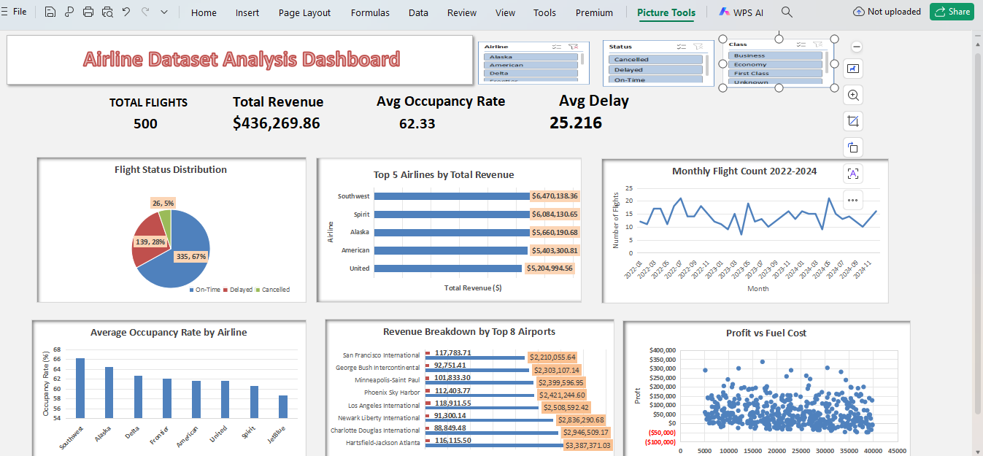
Everything in one view.
Interactive dashboard built in Excel combining all KPIs, charts, and filters in a single view.

Slide 15
Key Insights
What we found that actually matters.
Dirty data was hiding $millions — 31 zero revenue rows were not real zeros, they were data entry errors totalling hundreds of thousands in uncounted revenue
Punctuality does not equal profitability — JetBlue is the most punctual airline yet generates the least revenue and profit
Nearly 4 in 10 seats fly empty — 62% occupancy across all airlines signals a major untapped revenue opportunity through dynamic pricing
Atlanta dominates everything — busiest departure city, highest revenue airport and above average on-time performance
Fuel cost is a red herring — what actually drives profit is ticket price and how full the plane is, not how much fuel it burns

Slide 16
Findings
Finding 1 — Operational Performance
Despite 66.9% of flights arriving on time, over 1 in 3 flights experienced a delay or cancellation. Southwest and Spirit consistently rank worst for delays yet generate the highest revenues, suggesting passenger demand is not sensitive to punctuality in this dataset.
Finding 2 — Revenue & Profitability
Southwest leads all airlines in both total revenue ($6.47M) and total profit ($4.17M). However United generates the highest profit per flight ($63,460), indicating better cost efficiency per route despite lower overall volume.
Finding 3 — Capacity Utilisation
The average occupancy rate of 62.33% across all airlines reveals significant unused capacity. Nearly 4 in 10 seats fly empty on every flight, representing a major unrealised revenue opportunity.
Finding 4 — Data Quality Impact
10 data quality issues were identified and resolved before analysis. Notably 31 zero revenue rows were confirmed as data entry errors — not real values — meaning any analysis on the raw data would have produced misleading conclusions.

Slide 17
Limitations
Dataset size — 500 flights is relatively small and may not represent real-world patterns
Synthetic data — this is a demo dataset so findings cannot be generalised to real airlines
Missing cost data — only fuel and crew costs are available, other operating costs are excluded from profit calculation
No external factors — weather, air traffic control and seasonal events are not accounted for in delay analysis
Imputed values — 49 missing values were filled using statistical methods which introduces some estimation error

Slide 18
THANK YOU
We cleaned 500 records, fixed 10 data quality issues and uncovered insights that raw data could not show
Southwest dominates revenue and profit — but punctuality and efficiency tell a different story
62% occupancy and rising delays signal clear opportunities for operational improvement
This project proves that before any analysis, data quality is everything.
Thank You
Questions & Answers Welcome

